Slide 1

Economics

Slide 2
What is economics?
Lets create a classroom definition
https://www.youtube.com/watch?v=nWPrMmv1Tis

Slide 3

What is Economics?
Textbook defines it as “the study of how we make decisions in a world where resources are limited.”
  *the production, distribution, and consumption of goods and services

Slide 4

What is Economics?
There will always be a demand for things people need and things they want.
  What are needs? Wants?
Needs = required for survival
Wants = make life more comfortable and enjoyable
Can anyone think of examples of each?

Slide 5

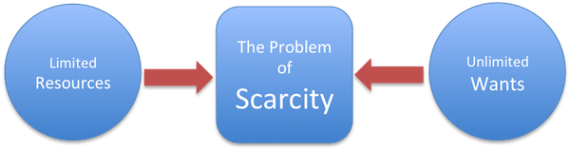
Scarcity
Since we have unlimited wants and limited resources, this leads to scarcity.
What are some examples of scarce resources? Resources that are not scarce?
Resources can be scarce in some areas and not in others
Notes:
We always want/need more and more but there isn’t always enough resources
Scarcity is when there are not enough resources to meet our needs and wants.
What are examples of scare resources?
Clean water, land, food,

Slide 6
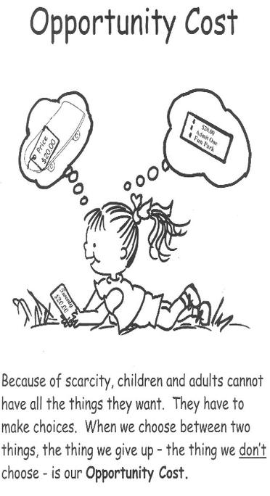

Slide 7
Scarcity
There are three things you should know about scarcity:
  Scarcity is not the same as poverty.
  Scarcity requires rationing
    This is generally done through price.
  Leads to competition.
    Definition = struggle between consumers and producers to get the best goods and services at the lowest price.

Slide 8
Law of Supply
as the price of an item goes up, suppliers will attempt to maximize their profits by increasing the quantity offered for sale - businesses will provide more products when they can sell them at higher prices
Law of Demand
the higher the price, the lower the quantity demanded - consumers will purchase fewer products when they must buy them at higher prices
https://www.youtube.com/watch?v=S4m2VymD9k0

Slide 9
Law of Supply and Demand
the effect that the availability (supply) of a particular product and the desire (or demand) for that product has on price
  low supply + high demand = higher price
  greater supply + lower demand = lower price

Slide 10
Reflection Q #1
How well can you differentiate between a good and a service
  #1- I cannot differentiate between a good and a service
  #2 a good is a tangible object that is produced and a service is something that cannot be weighed or measured
  #3 I understand 2 and 3- a service must contain some interaction between the business and the customer; whereas a good is something produced separate from the customer and does not require an interaction.
  #4 I understand 2, 3 and 4- a service is something that is time dependent, or perishable. Where a good can be stored and used later.

Slide 11
Reflection Q 2
Your understanding of the laws of supply and demand
#1 I do not understand how supply and demand interact to formulate a price
#2 I understand that the law of demand is inverse to price; one demands more of an item as the price declines and less of an item as the price increases
#3 I understand #2 and #3- the law of supply dictates a company will increase production if the item is selling for higher price and vice versa
#4 I understand 2, 3 and #4 the relationship between supply and demand from the producer and consumer will dictate the price of an item

Slide 12
Reflection Q 3
Your understanding of scarcity
#1 I do not understand that products/services are scarce in our society
#2 I understand that products/items are scarce
#3 I understand #2 and that some items are more scarce than others
#4 I understand 2, 3 and 4 that scarce items, paired with unlimited wants and needs, requires humans to ration items
#5 I understand 2, 3, 4 and 5 that scarcity causes competition for items/services, which is resolved by creating a monetary system (price)

Slide 13
How do you think you would do at rationing scarce resources?

Slide 14


Notes:
Scientists from FSU were conducting experiments involving zombies and they lost control of their specimens. They are now terrorizing the city of Tallahassee and Governor Scott has declared that the city is now under quarantine. Mrs. Schroepfer’s __ Period 7th Grade Civics classroom at Deerlake Middle School is the last human stronghold, but our resources are running low. How do we allocate our last bit of resources for optimal survival?”

Slide 15
Introduction
Take your group’s food resources, but DO NOT eat them yet!
Identify the oldest member of your group. They are in charge to start with. You may change this as you go along.
Notes:
“Scientists from FSU were conducting experiments involving zombies and they lost control of their specimens. They are now terrorizing the city of Tallahassee and Governor Scott has declared that the city is now under quarantine. Mrs. Schroepfer’s __ Period 7th Grade Civics classroom at Deerlake Middle School is the last human stronghold, but our resources are running low. How do we allocate our last bit of resources for optimal survival?”

Slide 16
Round 1
Knowing that we will be quarantined for a very, very long time, we need to allocate our resources…..How do you divide up the resources? Remember, the oldest person is in charge
Provide an outline of how you divided it and then use the space to say why.
Notes:
After a few minutes – ask groups to share.

Slide 17
Round 2
Now it’s time reallocate your supplies again…..
Assign each member of your group a role (the oldest person decides)
  Most Skilled
  Hardest Working
  Wealthiest
  Oldest
Now that everyone has a role – who should be in charge? Let the group decide….. Should it still be the oldest member – or maybe the most skilled or someone else……
What about the member of the group with the most skills? Do they get any more or less?
What about the smartest person, the wealthiest person, the oldest person?
Do they get more food? Less food? Should everyone get equal amounts of food?
Notes:
After a few minutes – ask groups to share.

Slide 18
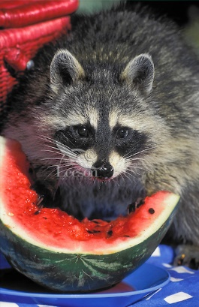
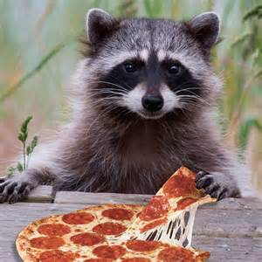
Round 3
Oops
Over night, a group of animals got into your food supply and infected 25% of your food supply. They have also INJURED the leader of your group in an attempt to get to the whole group
What do you do now? Now reallocate your resources for one final time……..
Record how you decided on your final allocation…….(who got what and why?)
Notes:
After a few minutes – ask groups to share.

Slide 19
What does this all mean?
How did the scarcity of resources affect your decision making?
What other examples can you think of where scarce resources are divided up?
How did it make you feel if your group decided to give you less “food?”
Notes:
How did the scarcity of resources affect your decision making?
What other examples can you think of where scarce resources are divided up?
How did it make you feel if your group decided to give you less “food?”

Slide 20

Making Economic Decisions

Slide 21

Three Basic Questions
An economy needs to answer three basic questions because of scarcity:
  How to produce
  What to produce
  For Whom to produce

Slide 22
Trade-offs
The alternative you face if you decide to do one thing rather than another.
  Scarcity forces us to make choices
When you face trade-offs, there is always an opportunity cost
  Definition = Highest valued alternative
  What is the opportunity cost of playing 2 hours of video games, or watching content from the internet after dinner tonight?

Slide 23
Other Costs
  Fixed = are always the same
  Variable = change with the # of products
  Total = Fixed + Variable
  Marginal cost= extra cost of each additional unit.
  Marginal benefit= extra benefit of an action or decision.
    Additional value

Slide 24
Making Economic Decisions:
Cost-Benefit Analysis
Comparing marginal cost and marginal benefit.
If we decide rationally, we should choose actions where the benefits are greater than the costs.
Examples of when we make poor cost-benefit decisions?
Notes:
Regular Buffet = $5
Steak Dinner + Buffet = $8
Marginal Cost = $3
Marginal Benefit = Steak
Which is of higher value to you?

Slide 25

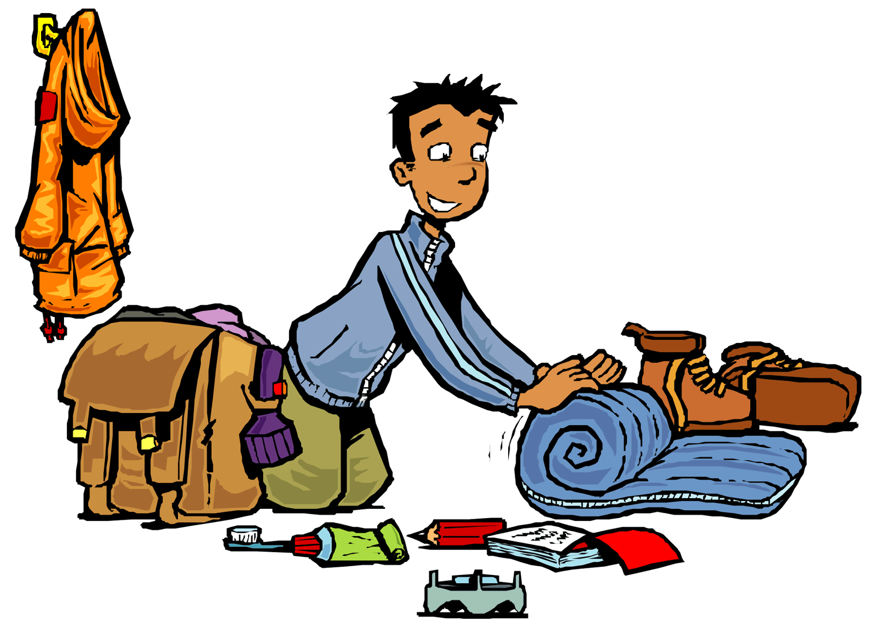

Packing for the trip of a lifetime!

Slide 26
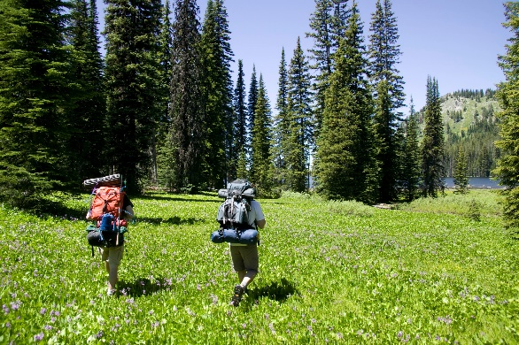

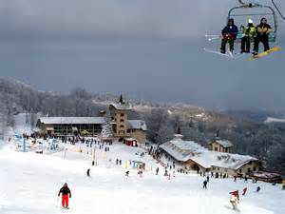


Where are we going?
You decide!
You will be packing according to destination.

Slide 27
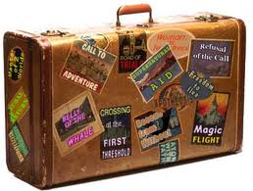
Packing your suitcase
Since we are travelling by plane, the TSA will only allow us to travel with 10 items, not including hygiene products
What are you packing?
Pick 10 items

Slide 28
Oh no!

Slide 29
TSA has stopped you in Security!
TSA has changed regulations and you can now only take 5 items in your suitcase.
What are you leaving and what are you keeping?
  Make sure to think about the cost of leaving it behind vs. benefit of taking it.

Slide 30
Reflection Questions
How did you decide what to leave?
What is the opportunity cost of your last item you decided to keep?
How did you use cost benefit analysis?

Slide 31
Wednesday, April 12th
Take out green online EOC packet, there is a check today!
Review these questions from yesterday with a shoulder partner:
  -What are the three basic questions an economy answers? This is because of what?
  Variable:
  Marginal Cost:
  Marginal Benefit:
  When making economic decisions you have to compare
  ___________ _____ + ___________ ________

Slide 32
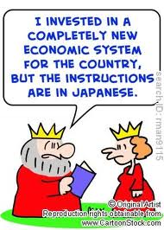
Economic
Systems

Slide 33
Traditional Economies
A pure traditional economy answers the basic economic questions according to tradition.
Things are done as they were in the past based on tradition, customs, and beliefs (religious). People grow their own food and make their own goods.
Examples: Certain areas in developing counties.

Slide 34

Command Systems
The government controls the factors of production.
The individual has little influence over how the economic questions are answered in a pure command system.
Examples: North Korea, Cuba

Slide 35

Market Systems/Free Market Economy
A system based purely on capitalism.
In this system the government does not intervene.
People own the factors of production and decide the answer of the basic economic questions. Buyers and sellers exchange goods and services as they choose.
Examples: 19th century Britain

Slide 36

Mixed Economic Systems
This economic system contains elements of the market and command system of government with few elements of traditional economics.
Examples: United States and most other Nations.

Slide 38
Types of Economic Systems – Comparison Chart “Who decides?”
 | TRADITIONAL SYSTEM | COMMAND SYSTEM | MARKET SYSTEM | MIXED SYSTEM
WHAT TO PRODUCE? | People follow their customs and make what their ancestors made | Government makes all economic decisions | Businesses base decisions on supply and demand and free enterprise (Price) | Businesses
HOW TO PRODUCE? | People grow and make things the same way that their ancestors did | Government decides how to make goods/services | Businesses decide how to produce goods | Businesses, but the government regulates certain industries
FOR WHOM TO PRODUCE? | People in the village who need them | Whoever the government decides to give them to | Consumers | Consumers

Slide 39






Economy Continuum
Command
Market
Cuba
Russia
Germany
UK
US
Australia

Slide 40
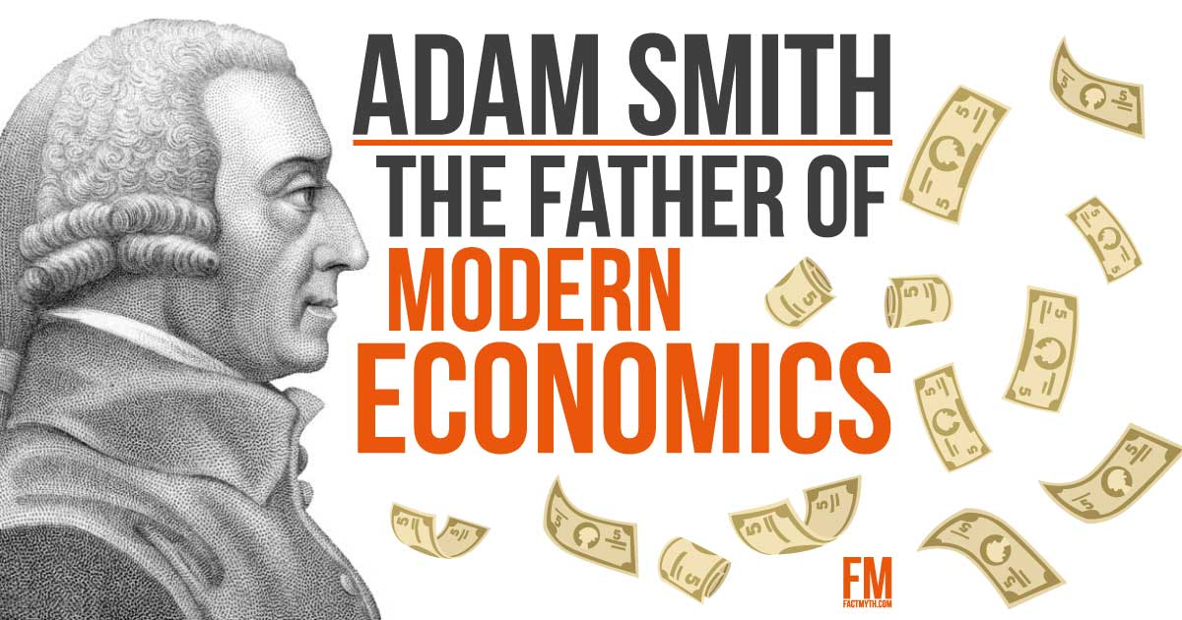
Adam Smith and Capitalism
Scottish economist and philosopher
Wrote The Wealth of Nations in 1776.
  Individuals left on their own would act in their own self-interest.
  Guided by “invisible hand.”
    https://youtu.be/ulyVXa-u4wE
  Role of government is to guarantee free competition.
  Laissez-faire economics = “to let alone,” government does not interfere in the marketplace.
Influenced the philosophy on economics of the Founding Fathers.

Slide 41

Capitalism
Capitalism - An economic system in which private citizens own and use the factors of production in order to seek profit.
Another term used is free enterprise, which is a system which allows competition to flourish.
Sprung from two concepts:
  People could work for economic gain.
  Government should have a limited role in the economy

Slide 42
Components of Capitalism
  Markets = where prices of goods and services are determined
  Economic Freedom = ability to choose job and when/where we want to work.
  Private Property Rights = freedom to use an own our property as we see fit.

Slide 43
Components of Capitalism
  Competition = struggle between buyers and sellers to get lowest prices.
  Profit Motive = driving force that encouraged people to improve position
  Voluntary Exchange = buyers and sellers freely and willingly engaging in market transactions

Slide 44
Thursday, April 14th
Take out Economics outlines
Review from Wednesday by yourself:
  Traditional
  Command
  Market
  Mixed
  Pick two and explain: How they decide what to produce, how to produce, and for whom to produce?

Slide 45
Review!!
What are the three basic economic questions?
Define scarcity
What is the law of supply and demand?
Define competition
Define monopoly
What is a command economy?
What is a free market economy?

Slide 46
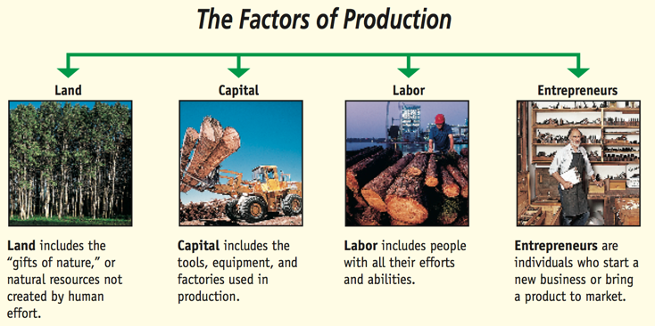
Factors of Production and GDP

Slide 47

Production in the U.S.
Generally produces two things:
  Goods
  Services

Slide 48
Factors of Production
The economic resources necessary to produce goods and services.
There are four types:
  Land
  Labor
  Capital
  Entrepreneurs

Slide 49
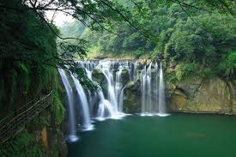
Land
Also known as natural resources.
“The gifts of nature.”
Examples:
  Land, rainfall, minerals, etc.
  Anything that is created by nature.

Slide 50

Labor
The physical and mental efforts that people contribute.
What types of things affect this resource?
  -Population growth, education, immigration, war, and disease.

Slide 51
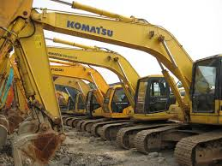
Capital
Manmade items: factories, tools, machinery, and buildings used to make other products.
What are the capital goods for a classroom?

Slide 52

Entrepreneurs
The people who use the other factors of production in new ways.
Opening new businesses and creating new products
Invention vs. Innovation – assumes risks for new business ventures
Examples from 20th and 21st Century:
  Steve Jobs
  Mark Zuckerburg
  Who else?

Slide 53
Productivity
Is the measure of the amount of output produced by a given number of inputs
What does that mean? How much you can make with a given number of resources.
Applies to all factors of production

Slide 54
Productivity
Ways to improve productivity
  Specialization = concentrating on one good or service
  Division of Labor = dividing one job into multiple smaller jobs.
  Investing in human capital, or the skills and abilities of people
Leads to economic interdependence. Why?

Slide 55
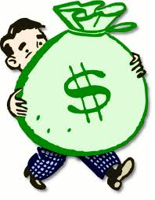
What is gross domestic product (GDP)?
Currency value (such as U.S. dollar) of all final goods and services produced within a country in a given period
Total income of a nation
Measure of a nation’s economic well-being
Measure of a nation’s economic growth from one period to the next

Slide 56
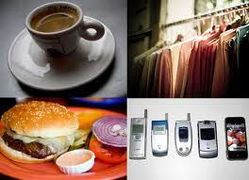
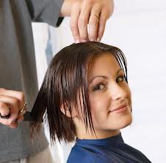
What’s included in GDP?
Consumption by households
  Goods: groceries, clothes, iPods
  Services: haircuts, oil changes
Notes:
Consumption (C) is the expenditure by households on consumption goods and services. It includes durables (goods lasting three or more years), nondurables, and services.

Slide 57
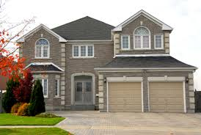
What’s included in GDP?
Investment by businesses and households
  Fixed assets for production
  New homes
  Inventories
Notes:
Investment (I) is the purchase of new capital goods (tools, instruments, machines, buildings, and other constructions) and additions to inventories. In other words, it is spending by firms, including final purchases on machinery, equipment and tools, all construction of new houses, buildings, and apartments, and additions to inventory.

Slide 58

What’s included in GDP?
Government expenditures by local, state, and federal government
  Roads and schools
Notes:
Government purchases of goods and services (G) are purchases of goods and services by all levels of government. It excludes transfer payments (welfare spending and unemployment compensation) because those payments do not represent new products or services; rather, they are transfers of income.

Slide 59

What’s included in GDP?
Net exports
  Value of a country’s exports to other nations, minus its imports from other nations
What goes out of U.S. minus what comes into U.S. = Net Exports
Notes:
Net exports of goods and services (X-IM or NX) is the value of exports of goods and services minus the value of imports of goods and services. In the United States, it is the value by which American spending on foreign goods and services exceeds foreign spending on American goods and services.

Slide 60
What’s included in GDP?
GDP = Consumption + Investment + Government spending + Net exports
Notes:
GDP is equal to all of the spending by households, businesses, government, and the international sector on final goods. It is also the dollar value of the nation’s goods and services produced in a given period within the nation’s borders.

Slide 61
What are the components of GDP?
GDP
Personal Consumption Expenditures
(C)
Investment
(I)
Government
(G)
Net Exports
(NX)
Fixed Investment
Inventories
Exports
Imports
Nonresidential
Residential
GDP = C + I + G + NX
Notes:
Expenditures on final goods and services are divided into four types: consumption, investment, government purchases, and net exports (exports – imports) of goods and services.

Slide 62
How much of GDP is each component?
Average Percent of GDP since 2003
Component % of GDP
Government 19%
Investment 16%
Consumption (PCE) 70 %
Net Exports -5%
GDP 100%
Source: Bureau of Economic Analysis
Notes:
The chart shows the average percent since 2003 of GDP for each component of GDP. Consumption is the highest proportion of GDP, at 70%. Government spending accounts for 19% of GDP on average, and investment, 16%. Net exports have averaged -5%. Since imports have exceeded exports, net exports has been a drag on GDP. Changes to components of real GDP will change the overall level of real GDP.
Calculated using data from the Bureau of Economic Analysis (BEA): www.bea.gov

Slide 63

What’s not included in GDP?
Intermediate goods
Used goods
Underground production (black market)
Financial transactions
Household production
  Stay-at-Home Moms
Transfer payments
Notes:
Intermediate goods. Only the final goods and services purchased for final use and not for resale or further processing and manufacturing are included in GDP. Intermediate goods are not counted in GDP. Intermediate goods are goods and services that are used for further processing and manufacturing or resale, for example, the lead that will eventually go in a pencil. This process avoids double-counting and therefore exaggerating GDP. Goods produced but not sold do go into GDP in the form of inventory investment. After that, they are not included in the GDP of the year in which they are sold.
Second-hand sales/used goods. Expenditure on used goods is not part of GDP because these goods were part of GDP in the period in which they were produced and during which time they were new goods. Buying a house that is not new is not part of GDP. Also, bartered goods are not included in GDP.
The black market/underground production. Illegal drugs, illegal goods, and illegal services in the underground economy are not part of GDP. The hidden part of the economy in which people trade in illegal goods and services and try to avoid taxes and regulations cannot be correctly ascertained.
Financial transactions. When households buy financial assets such as bonds and stocks, they are making loans, not buying goods and services. Nothing new has been produced.
Transfer payments. Transfer payments are payments from the government, including education grants, Social Security payments, welfare checks, and unemployment checks. They do alter household income, but they do not reflect the economy’s production.

Slide 64
Standard of Living
Quality of life based on the how much we have
  The availability of necessities and luxuries that make life easier.
Does having a lot of stuff make life better?

Slide 65
Quantity vs Quality
GDP measures how much, but not how well.
Examples:
  Music

Slide 66
What GDP does not tell us
Does not measure income distribution
Does not measure non-monetary output or transactions (e.g., barter, household activities)
Does not take into account desirable externalities, such as leisure or environment
Does not measure social well-being
Correlates to standard of living but is not a measure of standard of living

Slide 67
Friday, April 17th
Get out economics outline and EOC benchmarks that are due today
Look ahead to the benchmarks due next week
Economics test and highlighter study both next Tuesday!

Slide 68
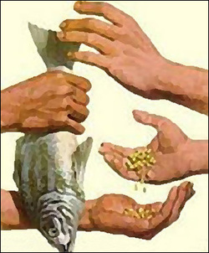
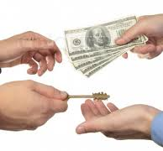
Money and Trade

Slide 69
Functions of Money
Has three functions:
  Medium of exchange
  Store of value.
  Measure of value.

Slide 70
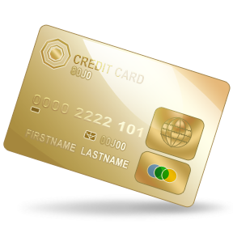
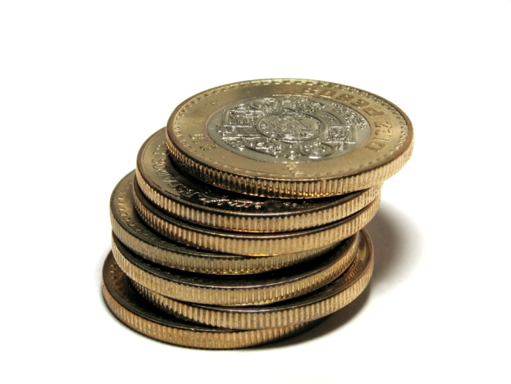
Types of Money
Anything people are willing to exchange for goods can be considered money.
Most common types of money today:
  Coins = metallic forms of money.
  Currency = coins and paper money.
  Checking Accounts
  Savings Accounts

Slide 71

Protecting the Financial System
Federal Deposits Insurance Corporation (FDIC)
  Insures individual accounts in financial institutions for up to $100,000!!

Slide 72
The Federal Reserve
Responsible for regulating the money in the US.
Also responsible for supervising the banking system in the US.
  Commercial Banks
  Savings and Loan Associations (S&Ls)
  Credit Unions
Primarily controls the amount of money in the US through monetary policy
  The actions that determine the size and rate of growth of the money supply, which in turn affects interest rates
  If the money supply grows too fast, the rate of inflation will increase; if the growth of the money supply is slowed too much, then economic growth may also slow

Slide 73
Why does Money have value?
Because WE say so!

Slide 74
Trade
Money facilitates trade because its value can transfer between countries.
  National trade – stays inside one country
  International trade – trade between countries
Why do we trade?
Because trade creates VALUE!

Slide 75
Trade Creates Value Activity
There will be 4 groups.
  Group 1 → Front of classroom
  Group 2 → Back of classroom
  Group 3 → By computers
  Group 4 → By the book shelf

Slide 76
Round One
Pick a piece of candy out of the bag (DO NOT EAT IT YET!)
Rate your happiness with the candy from 1-10
  1 being least happy
  10 being most happy
On your guided notes, write the sum of your group’s ratings under round one.

Slide 77
Round Two
Trade candies within your group
Rate your happiness with the candy from 1-10
  1 being least happy
  10 being most happy
On your guided notes, write the sum of your group’s ratings under round two.

Slide 78
Round Three
Trade candies with the other groups
GO BACK TO YOUR GROUP!
Rate your happiness with the candy from 1-10
  1 being least happy
  10 being most happy
On your guided notes, write the sum of your group’s ratings under round two.

Slide 79
GO BACK TO YOUR SEATS!
Share your sums with the rest of your class.

Slide 80
What was happening?
What did the trade within your group represent?
  National Trade
What did the trade between the groups represent?
  International Trade
Did trading increase your happiness with the candy you received?
Why do you think that is?

Slide 81
Monday, April 20th
Economics test and highlighter study due next class period

Slide 82

The Economy and YOU!

Slide 83

What can you do to be involved in the economy?
Keep informed!
  Read/Watch the news
  Gather information on businesses

Slide 84

What can you do to be involved in the economy?
Understand Incentives
  = rewards offered to try to get people to do something
  Ex. Jolly Ranchers/Candy

Slide 85
What can you do to be involved in the economy?
Understand the Role of Government
  To provide what the private sector cannot.
  Maintain competition
  Offering incentives

Slide 86


What is your role in the economy?
CONSUMERS!
Notes:
Means you buy stuff!

Slide 87
Consumer Rights
Consumerism: movement to educate buyers about the purchases they make and to demand better and safer products.
Consumer Bill of Rights
  5 major rights:
    Right to a safe product
    Right to be informed
    Right to choose
    Right to be heard
    Right to redress (payment for damaged goods).

Slide 88
Consumer Responsibilities
If your product isn’t working, it is the consumers responsibility to begin the process of getting it fixed
  NOT BY YOURSELF!
  Fixing it yourself will cancel warranty, the promise made by seller to repair or replace a product within a certain amount of time.
Ethical Behavior
  = respecting the rights of sellers and manufacturers.
  Ex. Returning a used item.

Slide 89
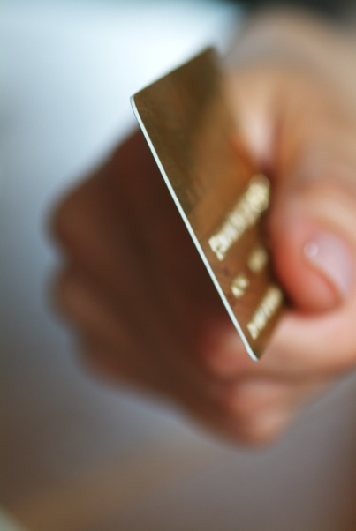

Role as a Consumer
Use of your income
  Disposable: Money left after taxes have been taken out.
  Discretionary: Money left after paying for necessities (rent, utilities, groceries, etc.)
You can pay using:
  Cash
  Charge Account/Credit Card
  Debit Cards

Slide 90
Role as a Consumer
Decision Making
  Opportunity Cost
  Is it worth it?
Budgeting
  Deciding how you will spend your money
  Consider your needs vs. wants

Slide 91
Role as a Consumer - Saving
= Setting aside a portion of your income.
Saving is good for the economy as a whole:
  You have more money to invest later.
  When a business saves, they can expand → more jobs!

Slide 92
Role as a Consumer - Saving
If you place your money in a savings account, you earn interest, the payment received when you lend money or allow someone else to use your money.
  Who has a savings account?
Saving involves a trade-off.
  Buying something bigger later vs. something smaller, cool now.

Slide 93
Test Review- Kahoot, matching……..figure out
Anything people exchange for goods is called…?
The Scottish author and philosopher that influenced our economic system is?
What are the four factors of production? Give a brief description of each.
What does the FDIC do?
Define opportunity cost.
What is a marginal benefit?
What does GDP mean?
What are the components of a capitalism?
What are the three basic economic questions?
Define scarcity
What is the law of supply and demand?
Define competition
Define monopoly
What is a command economy?
What is a free market economy?

